Slide 1
IBM University Engagement Project Submission
“Exploring the Power of Agentic AI with IBM Granite and IBM Bob”

Slide 2

Project Tile – ResearchNova AI — From Scattered Papers to Breakthrough Ideas
Domain of Project – Education
Student Name | Recent Passport Photo | Email ID | Mobile number [WhatsApp]
Prarthana B |  | prarthanafeb2007@gmail.com | 7019996348

Slide 3
Problem Statement -
Problem Statement No.7: Research Agent
The Challenge
Researchers, students, and professionals often deal with scattered academic papers, technical articles, and experimental data spread across multiple platforms. Filtering relevant knowledge, summarizing insights, and keeping track of the latest developments is time-consuming and inefficient. The challenge is not just to collect references but to synthesize, analyze, and generate actionable research insights in real time.
The Objective
Build an agentic AI application that acts as an intelligent research companion. The solution should:
- Fuse Academic Sources: Aggregate data from research papers, journals, preprints, and knowledge repositories, then synthesize them into clear, concise literature reviews.
- Enable Multimodal Research Input: Accept user queries, notes, charts, or even PDFs, and convert them into structured insights, references, and summaries.
- Create a Predictive & Agentic Layer: Highlight emerging trends, detect citation gaps, and predict promising directions for future research in a given domain.
- Visualize Research Insights: Provide an interactive dashboard with topic clusters, citation maps, sentiment/trend analysis, and concise knowledge graphs.
Tech Stack (Mandatory)
- IBM Langflow / IBM Orchestrate + IBM Models

Slide 4
Proposed Solution -
Proposed Solution: ResearchNova AI
1. Unified Research Platform:
Collect academic papers, journals, preprints, and research resources in one place.
2. AI-Powered Literature Review:
Summarize papers, compare findings, and generate literature reviews with citations.
3. Multimodal Input:
Accept research queries, PDFs, notes, and charts to generate structured insights.
4. Research Gap Detection:
Identify unexplored areas, research limitations, and opportunities for further study.
5. Predictive Insights:
Analyze emerging trends and suggest promising future research directions.
6. Interactive Dashboard:
Visualize topic clusters, citation maps, trends, and knowledge graphs.
7. Agentic AI Integration:
Use IBM Langflow / IBM Orchestrate and IBM Models to automate research workflows.
Expected Outcome:
Transform scattered academic information into organized, evidence-based, and actionable research insights.

Slide 5
Technology Used
IBM Bob platform -For designing and orchestrating multi-agent workflows visually
IBM Grainte model - for eg – ibm-granite-3-2-8b – For natural language understanding, reasoning, and personalization
IBM Cloud – It provides the infrastructure to build, deploy, and scale the Nutrition Agent efficiently. IBM Cloud enables a reliable, secure, and scalable environment for deploying the Nutrition Agent.
RAG– RAG to fetch real data first, then generate intelligent answers, making the Nutrition Agent more trustworthy and effective.
IBM Watsonx.ai - For model deployment, embeddings, and AI governance
Vector Database (FAISS/Chroma) – For RAG-based nutritional data retrieval

Slide 6
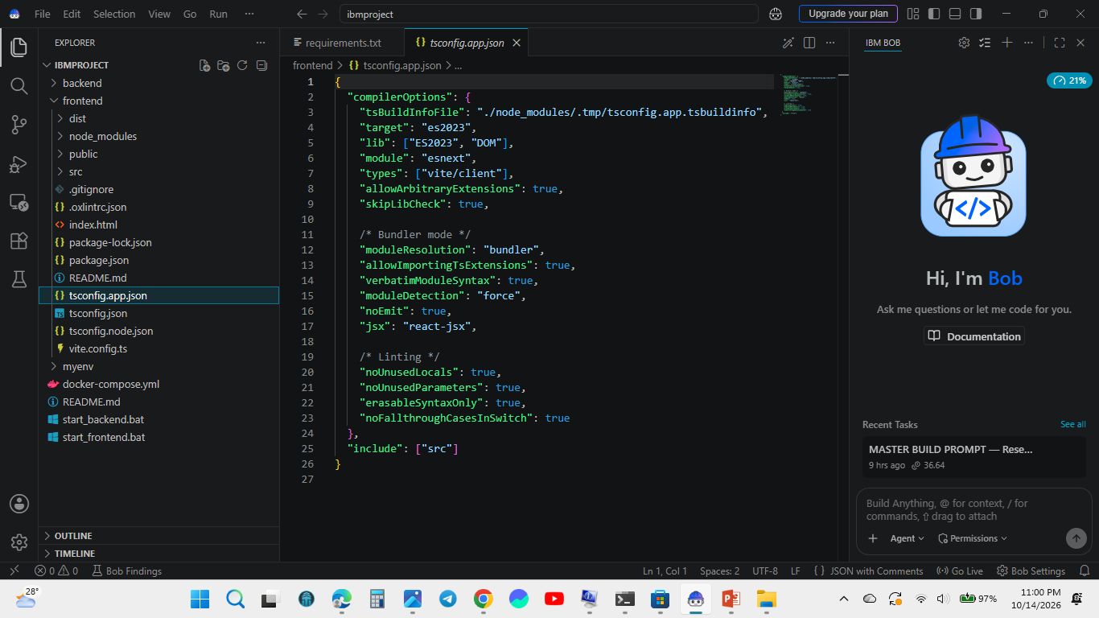
Required Files created using IBM bob -
.gitignore
.oxlintric.json
3. .index.html
4. .package-lock.json
package.json
README.md
tsconnfig.json
Vite.config.ts

Slide 7
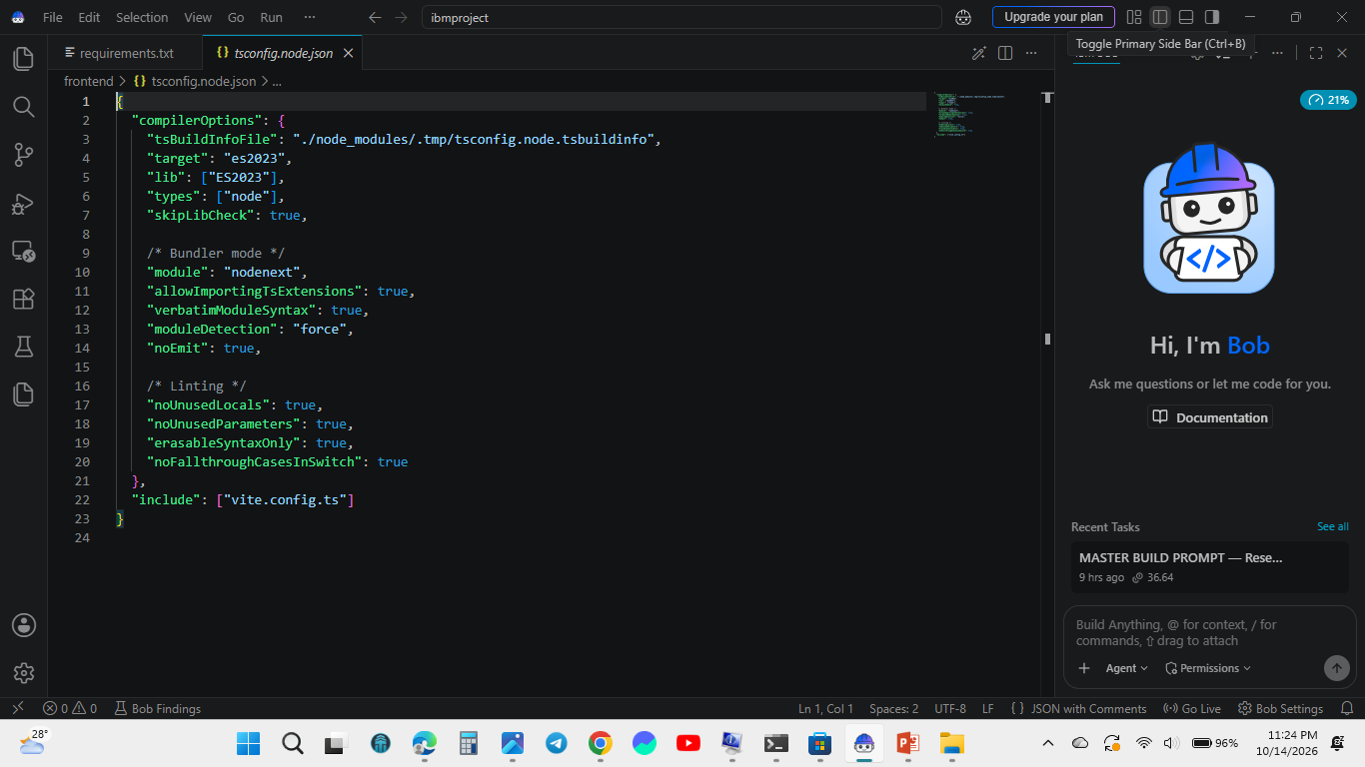
IBM Bob Screenshots:

Slide 8
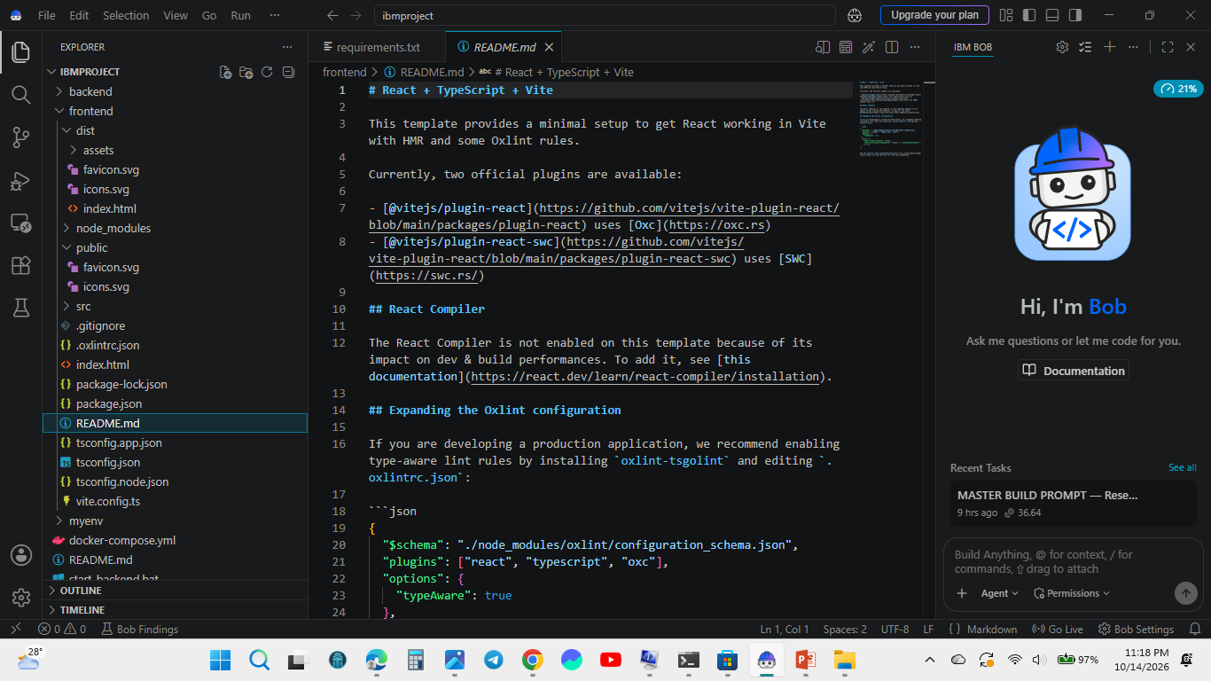

Slide 9
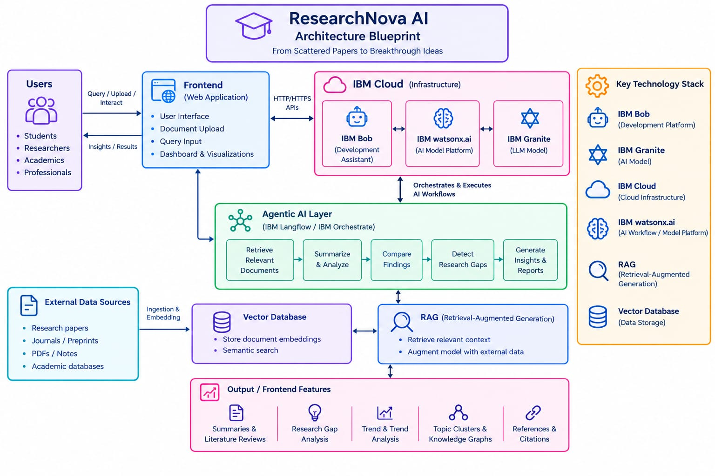
Architecture blueprint for IBM bob:

Slide 10

Role of Agentic AI in the solution
Role of Agentic AI in ResearchNova AI
1. Automated Research Workflow
Agentic AI acts as the intelligent coordination layer of ResearchNova AI, automating multiple research tasks. It retrieves relevant academic papers, processes uploaded PDFs and notes, summarizes important findings, and compares information across different studies, reducing the time and effort required for research.
2. Research Gap Detection and Predictive Insights
The system analyzes existing research to identify research gaps, highlight emerging trends, and suggest promising directions for future investigations. It helps students and researchers discover unexplored areas and gain meaningful insights from large volumes of academic information.
3. AI Integration and Intelligent Report Generation
IBM Langflow or IBM Orchestrate coordinates the research workflow, while IBM Granite supports AI-powered analysis and content generation. Retrieval-Augmented Generation (RAG) and a vector database help retrieve relevant information and provide context-aware responses. Together, these components transform scattered academic resources into structured literature reviews, evidence-based insights, and comprehensive research reports.

Slide 11
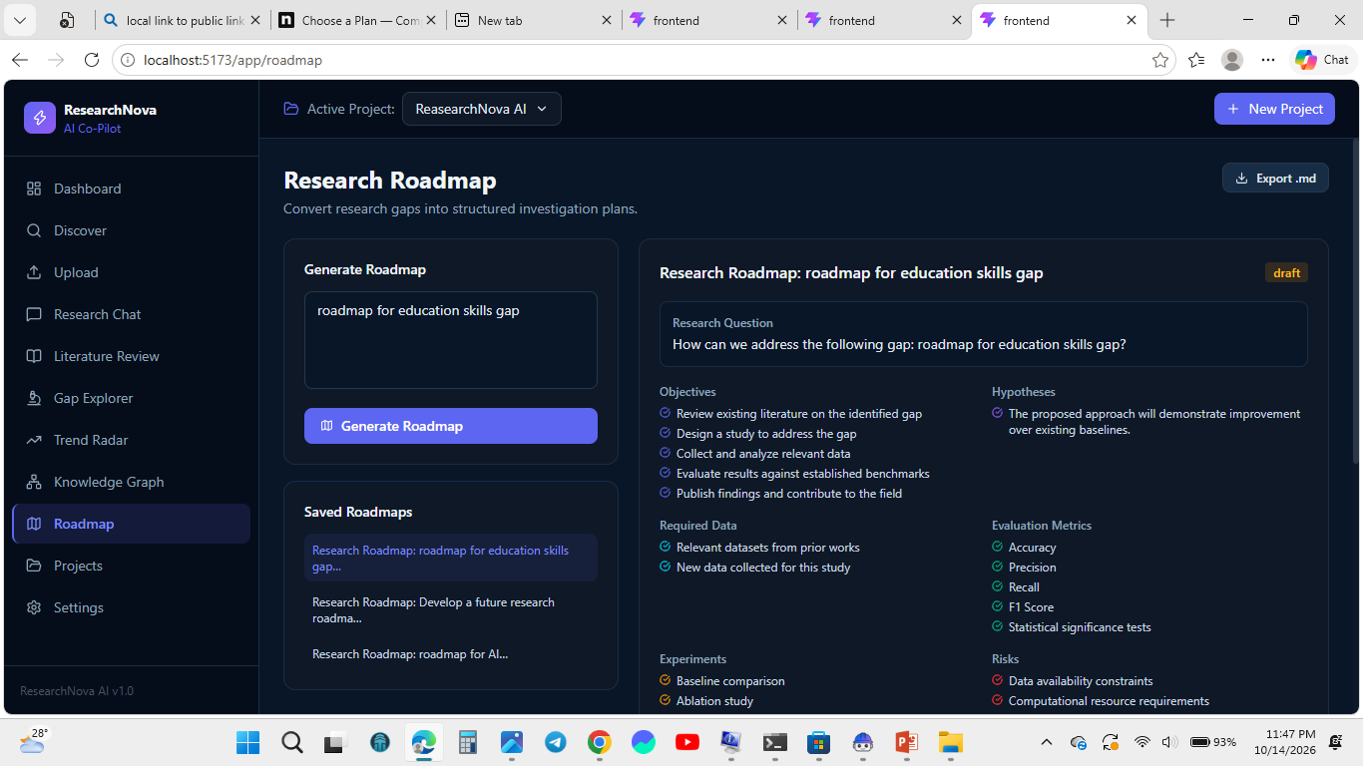
Project Output Screenshot
·
·
·

Slide 12
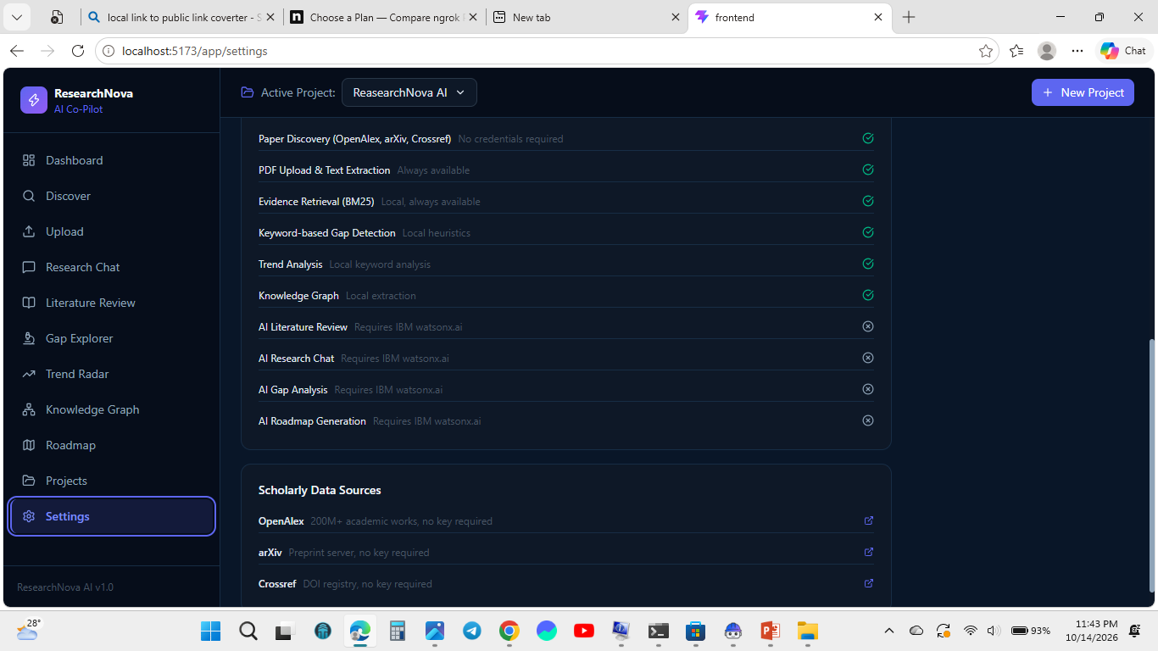
Project Output Screenshot
·
·
·

Slide 13
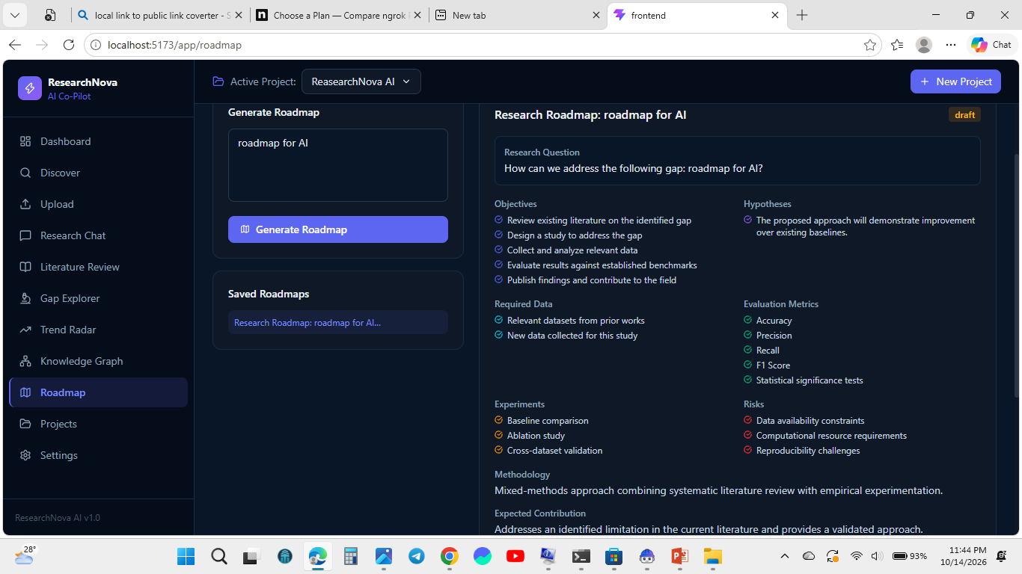
Project Output Screenshot
·
·
·

Slide 14
Project Output Screenshot
·
·
·

Slide 15
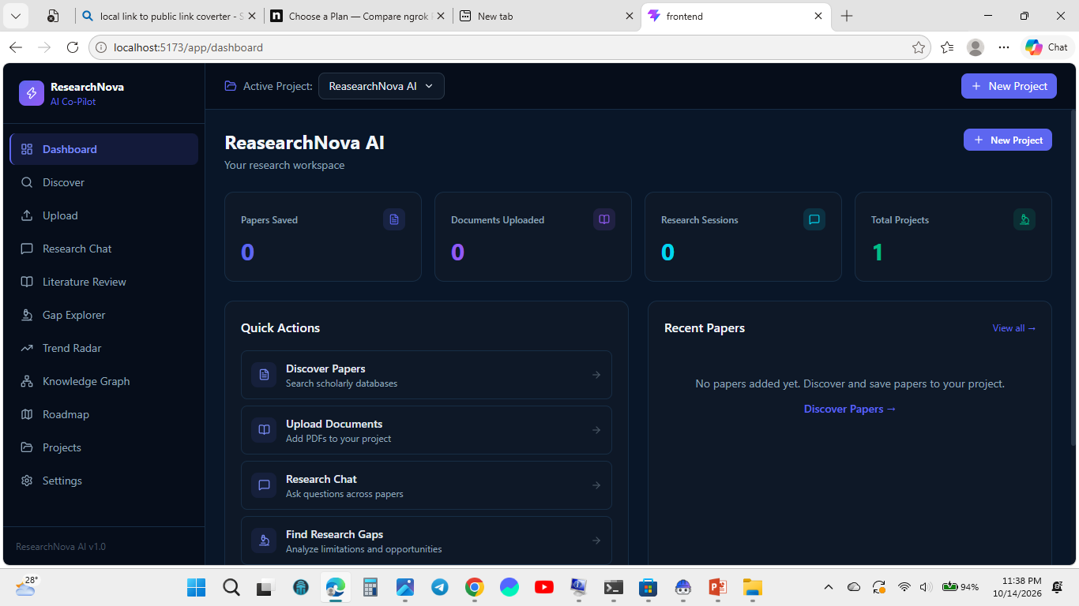
Project Output Screenshot
·
·
·

Slide 16
Novelty and Uniqueness
Research Roadmap: Novelty and Uniqueness
1. Research Problem Identification:
Define the research problem, explain its significance, and identify the major challenges that existing solutions fail to address. Establish clear research objectives and the expected benefits of solving the problem.
2. Literature Review:
Analyze relevant research papers, journals, and existing approaches to understand current developments in the selected domain. Compare their methodologies, findings, strengths, and limitations to establish a strong foundation for further investigation.
3. Research Gap Detection:
Identify unexplored areas, unanswered questions, and limitations in existing studies. Highlight opportunities where current methods can be improved or where new approaches could provide better results.
4. Novelty Identification:
Develop original research ideas based on the identified gaps. Suggest innovative methods, improved techniques, or alternative approaches that differentiate the proposed research from existing solutions and offer meaningful contribution
5. Validation and Evaluation:
Evaluate the proposed approach using relevant experiments, performance metrics, and comparisons with existing methods. Verify whether the approach addresses the identified research gap and delivers measurable improvements
6. Expected Contribution and Future Scope:
Describe the anticipated outcomes, potential applications, and significance of the research. Explain how the findings could contribute to the field, address real-world challenges, and inspire further research opportunities.

Slide 17
Git Hub Link
https://github.com/prarthana69/ResearchNova
·
·
·

Slide 18
Future Scope
1. Advanced AI: Enhance research gap detection to identify unexplored areas and suggest innovative research opportunities.
2. Real-Time Updates: Integrate additional academic databases to track newly published papers and emerging research trends.
3. Predictive Insights: Recommend promising future research directions by analyzing existing studies and publication trends.
4. Collaborative Research: Enable researchers to share notes, literature reviews, and findings for better teamwork.
5. Personalized Assistance: Generate customized research roadmaps and relevant paper recommendations based on users' interests and objectives.
·
·
·

Slide 19
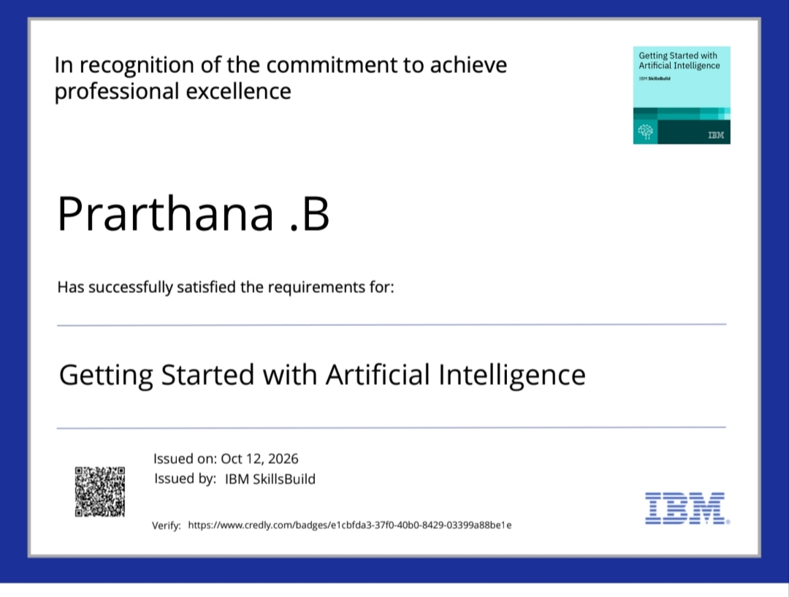
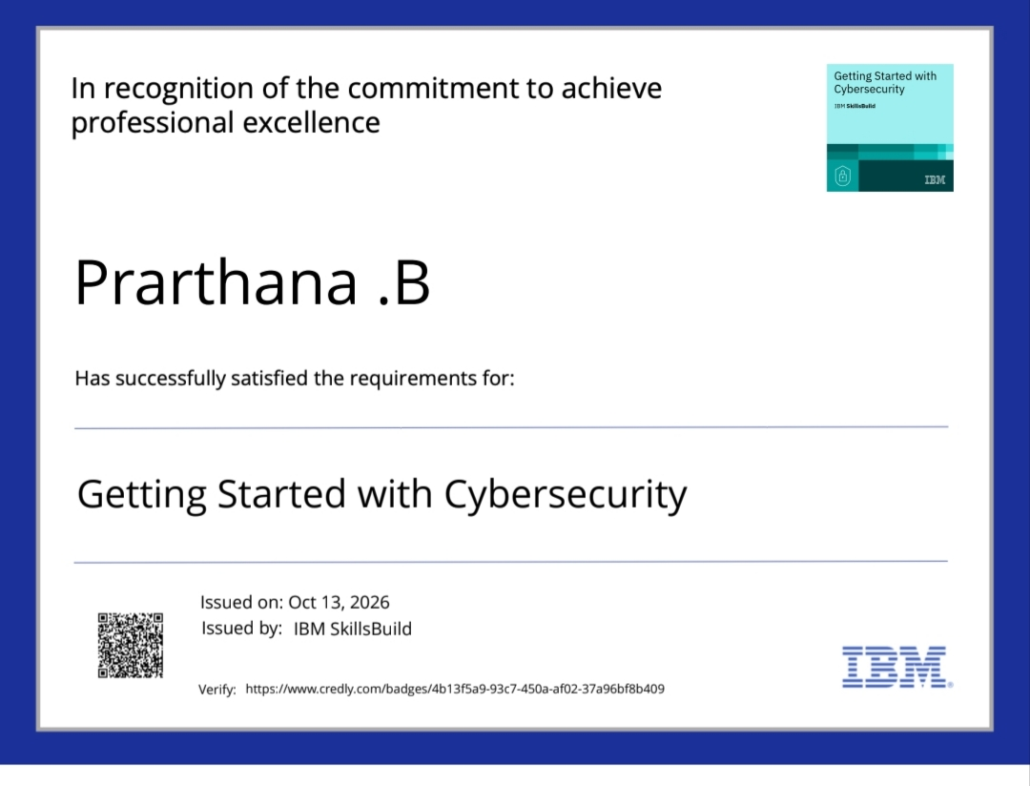
Certificates Earned:

Slide 20
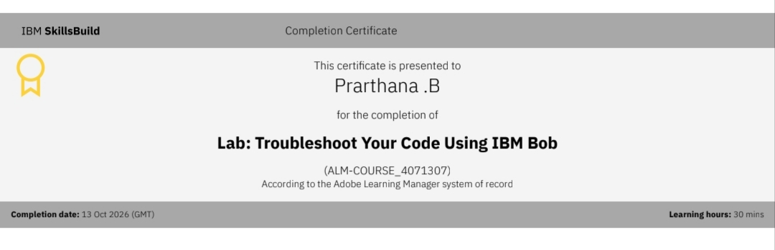
Certificates Earned:​
Add your IBM BOB Certificate

Slide 21


